Slide 1
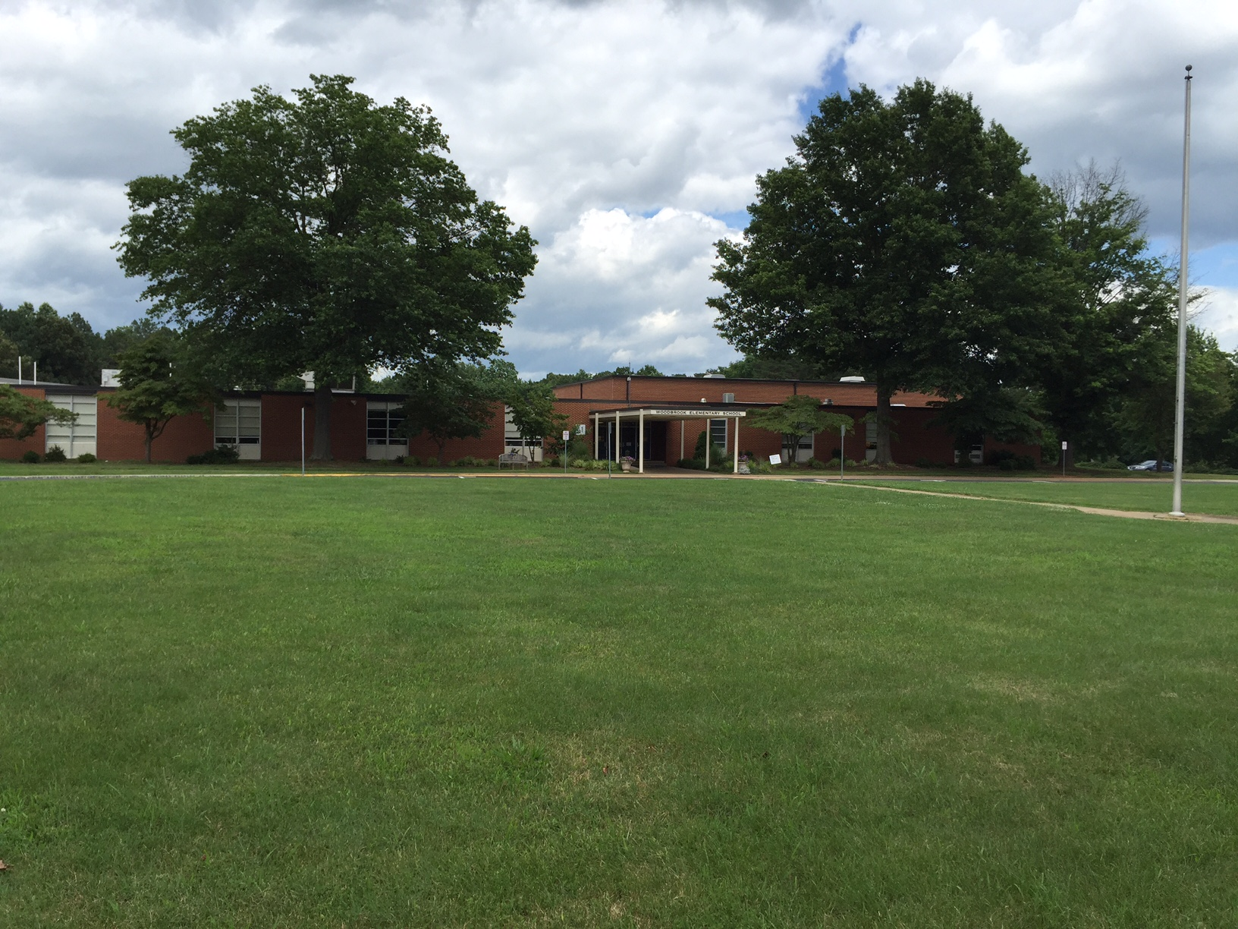

Design Development Presentation: December 8, 2016
Woodbrook Elementary School
Albemarle County Public Schools

Slide 2
Project Scope
General:
Modernize and expand Woodbrook Elementary School in order to provide additional student capacity in the urban ring
Additions:
Class Space, Gym, Music, Cafeteria expansion, Maker Space
Modernization and Renovations:
Modernize the existing class spaces
Various renovations throughout the school
Site Improvements:
Improve vehicular circulation: new bus loop, new parent drop-off
Additional parking for cars
New / Replacement Playgrounds and Outdoor Learning Areas
Woodbrook Elementary School

Slide 3
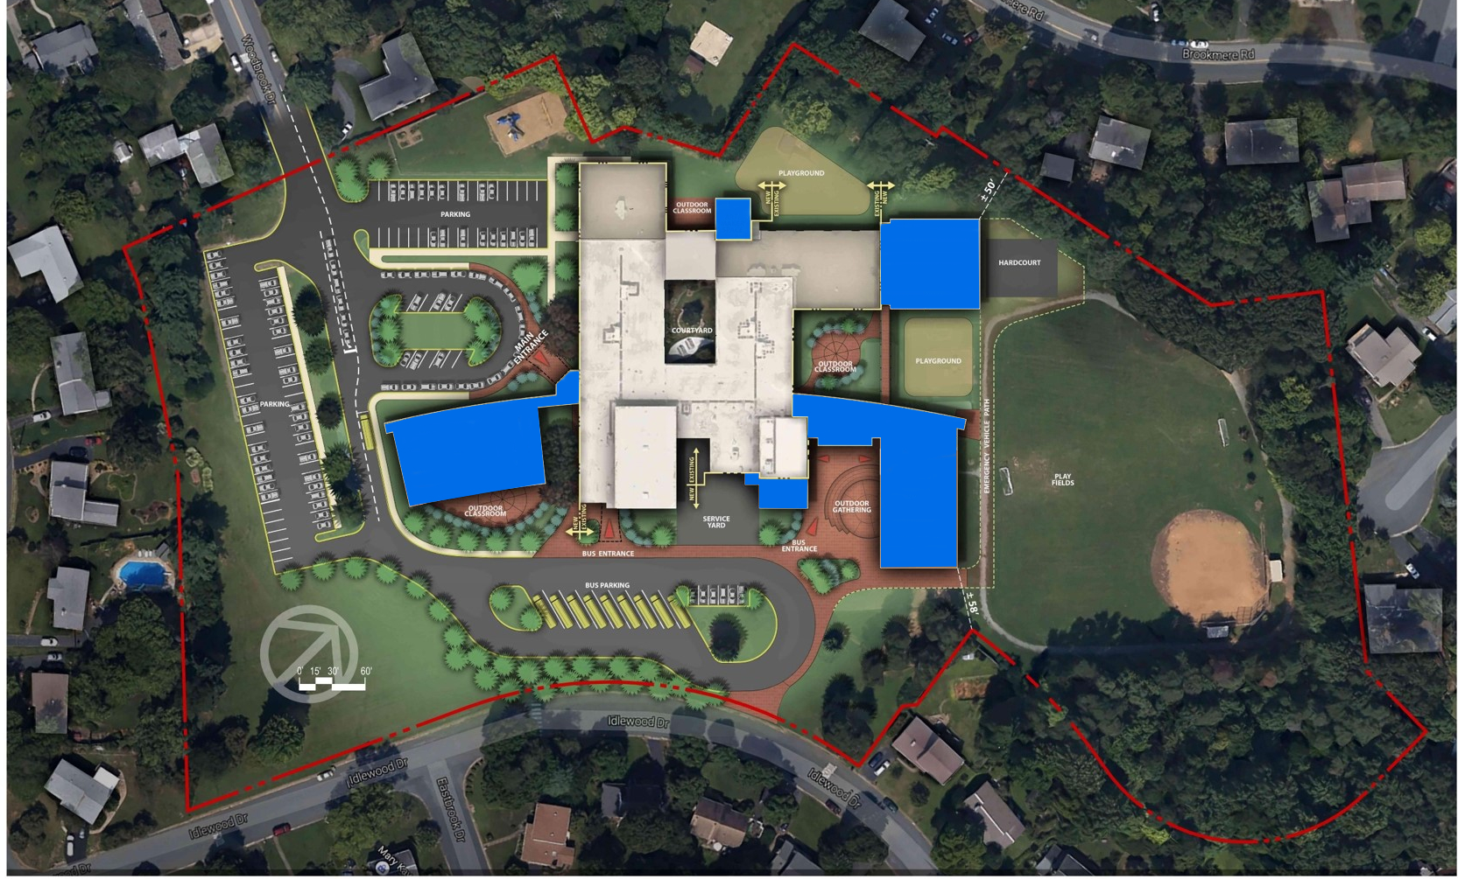

Slide 4
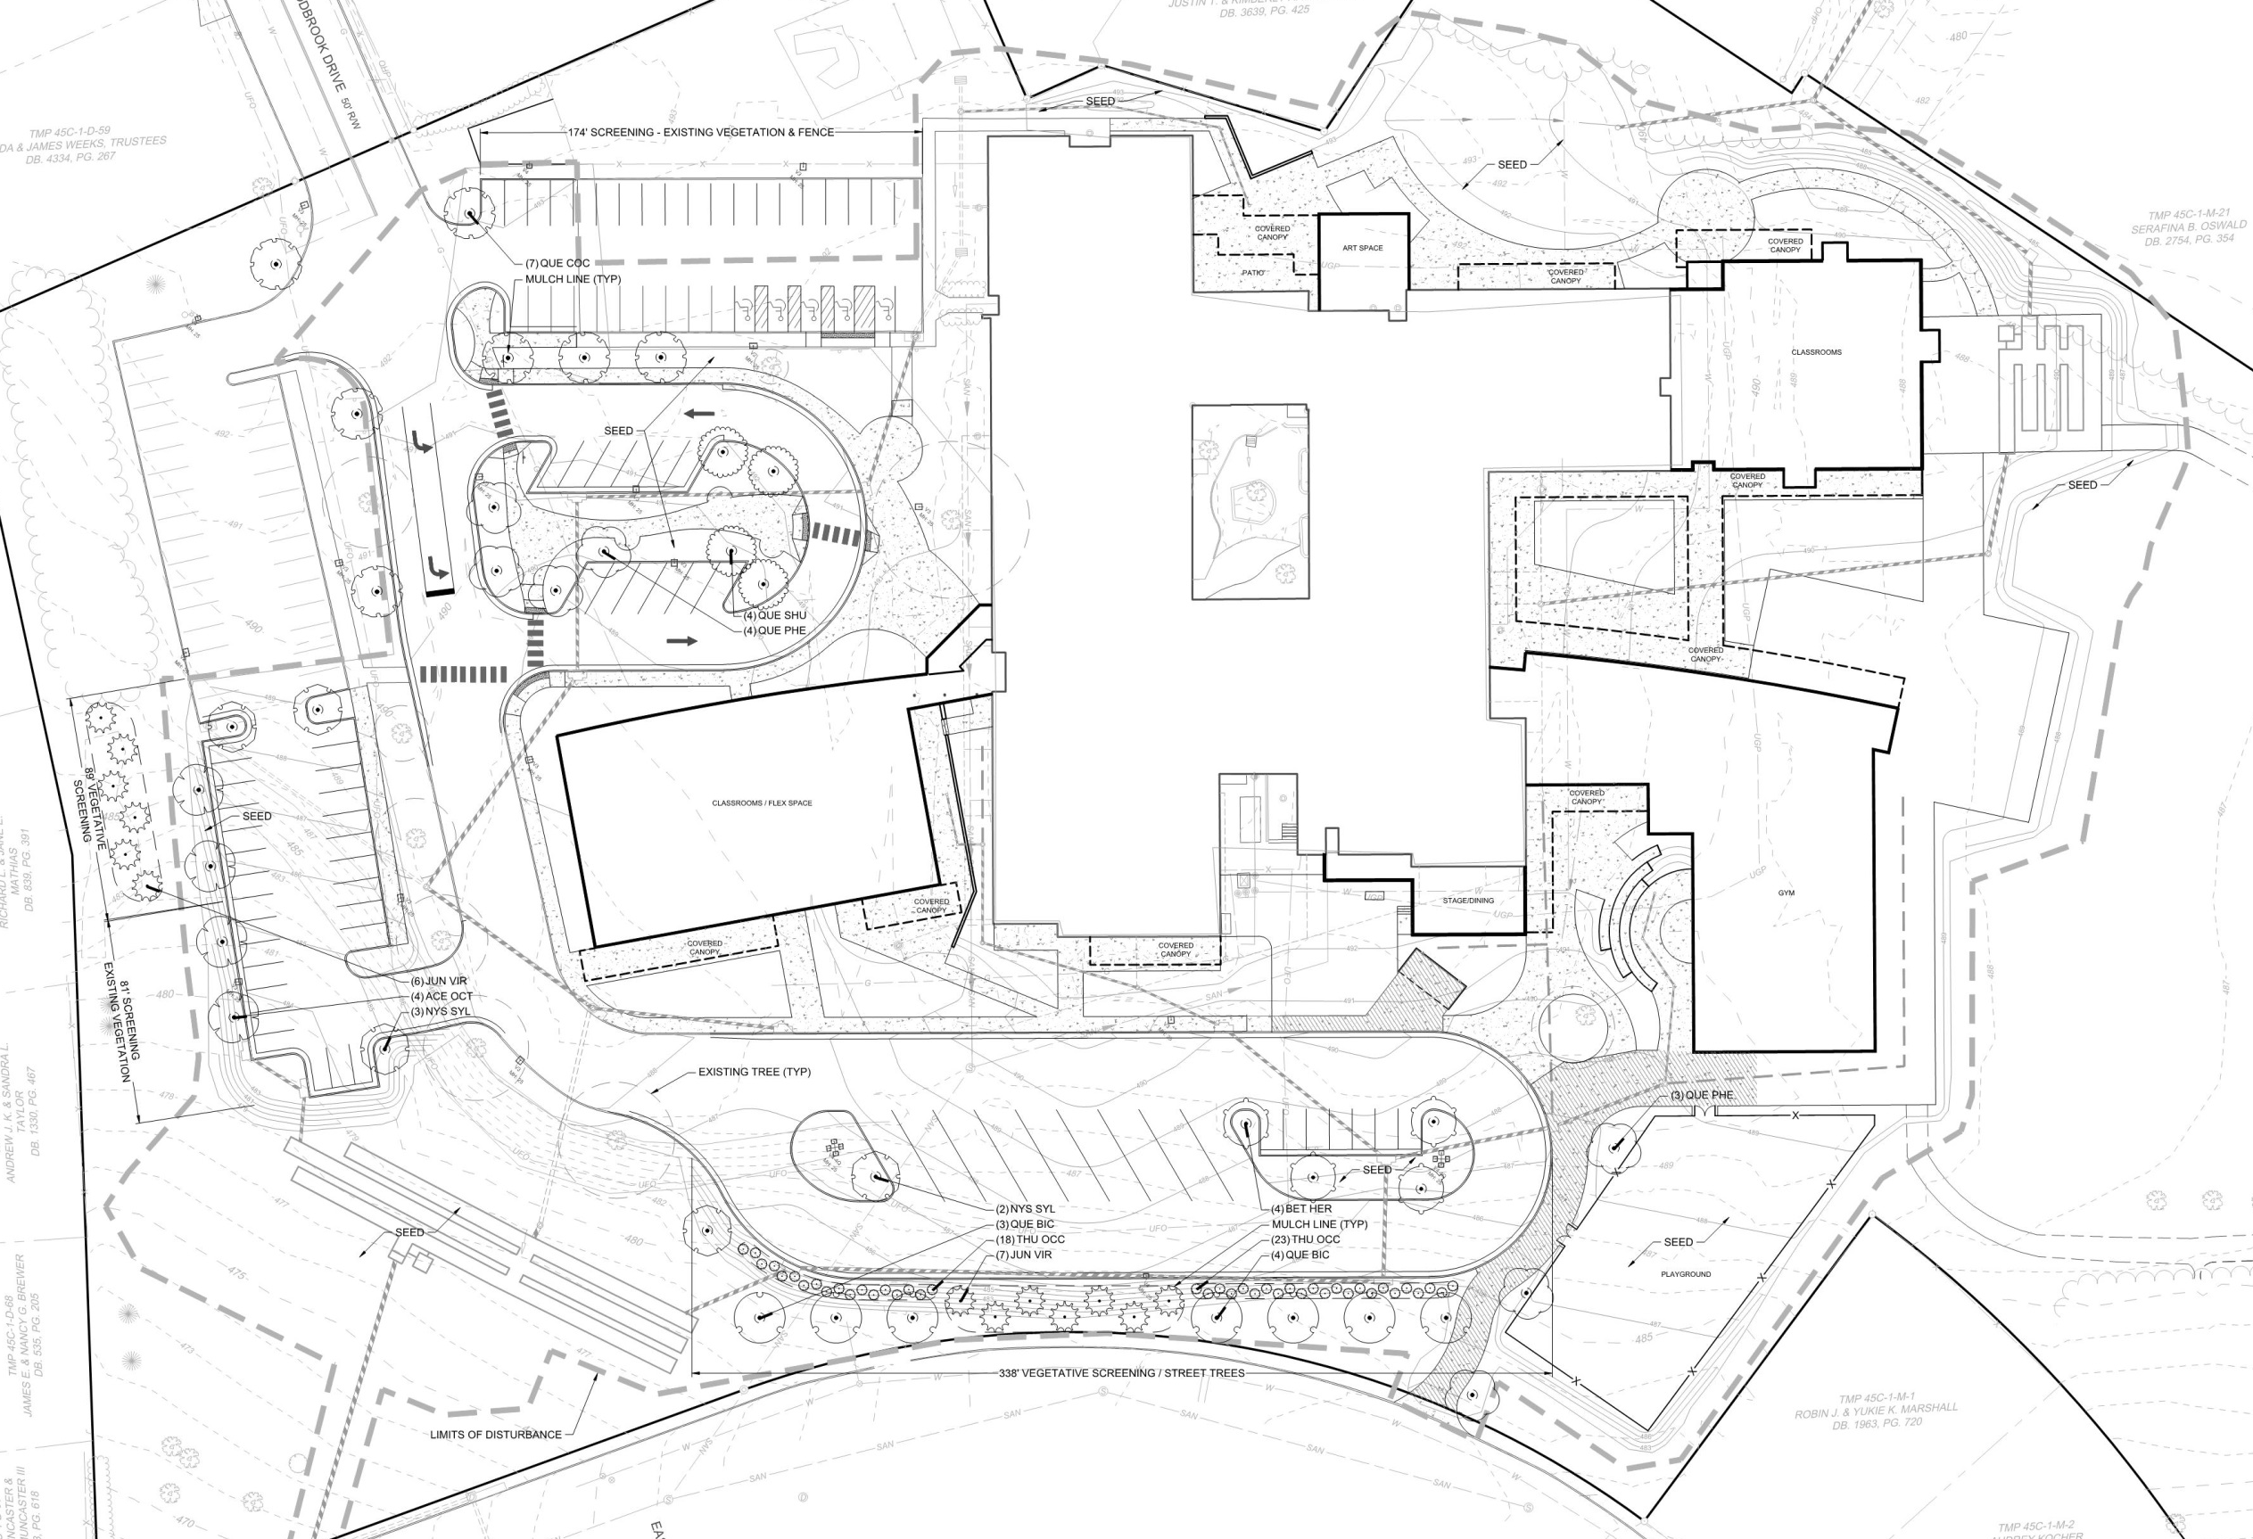

Slide 5
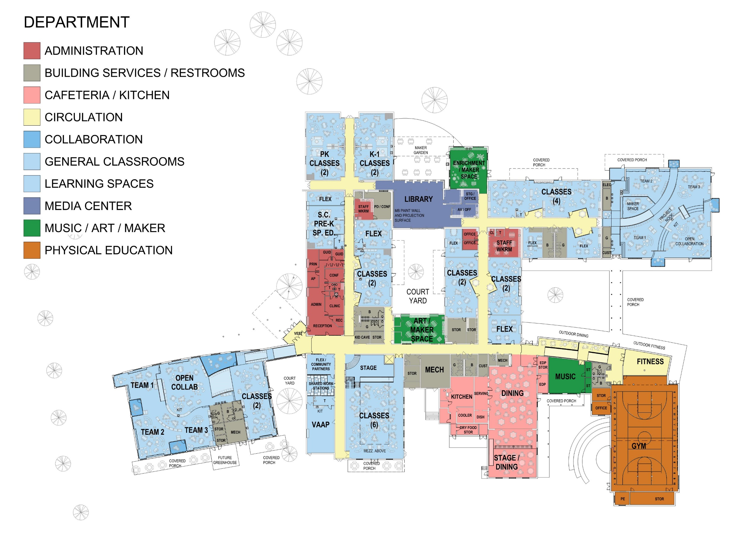

Slide 6


Slide 9
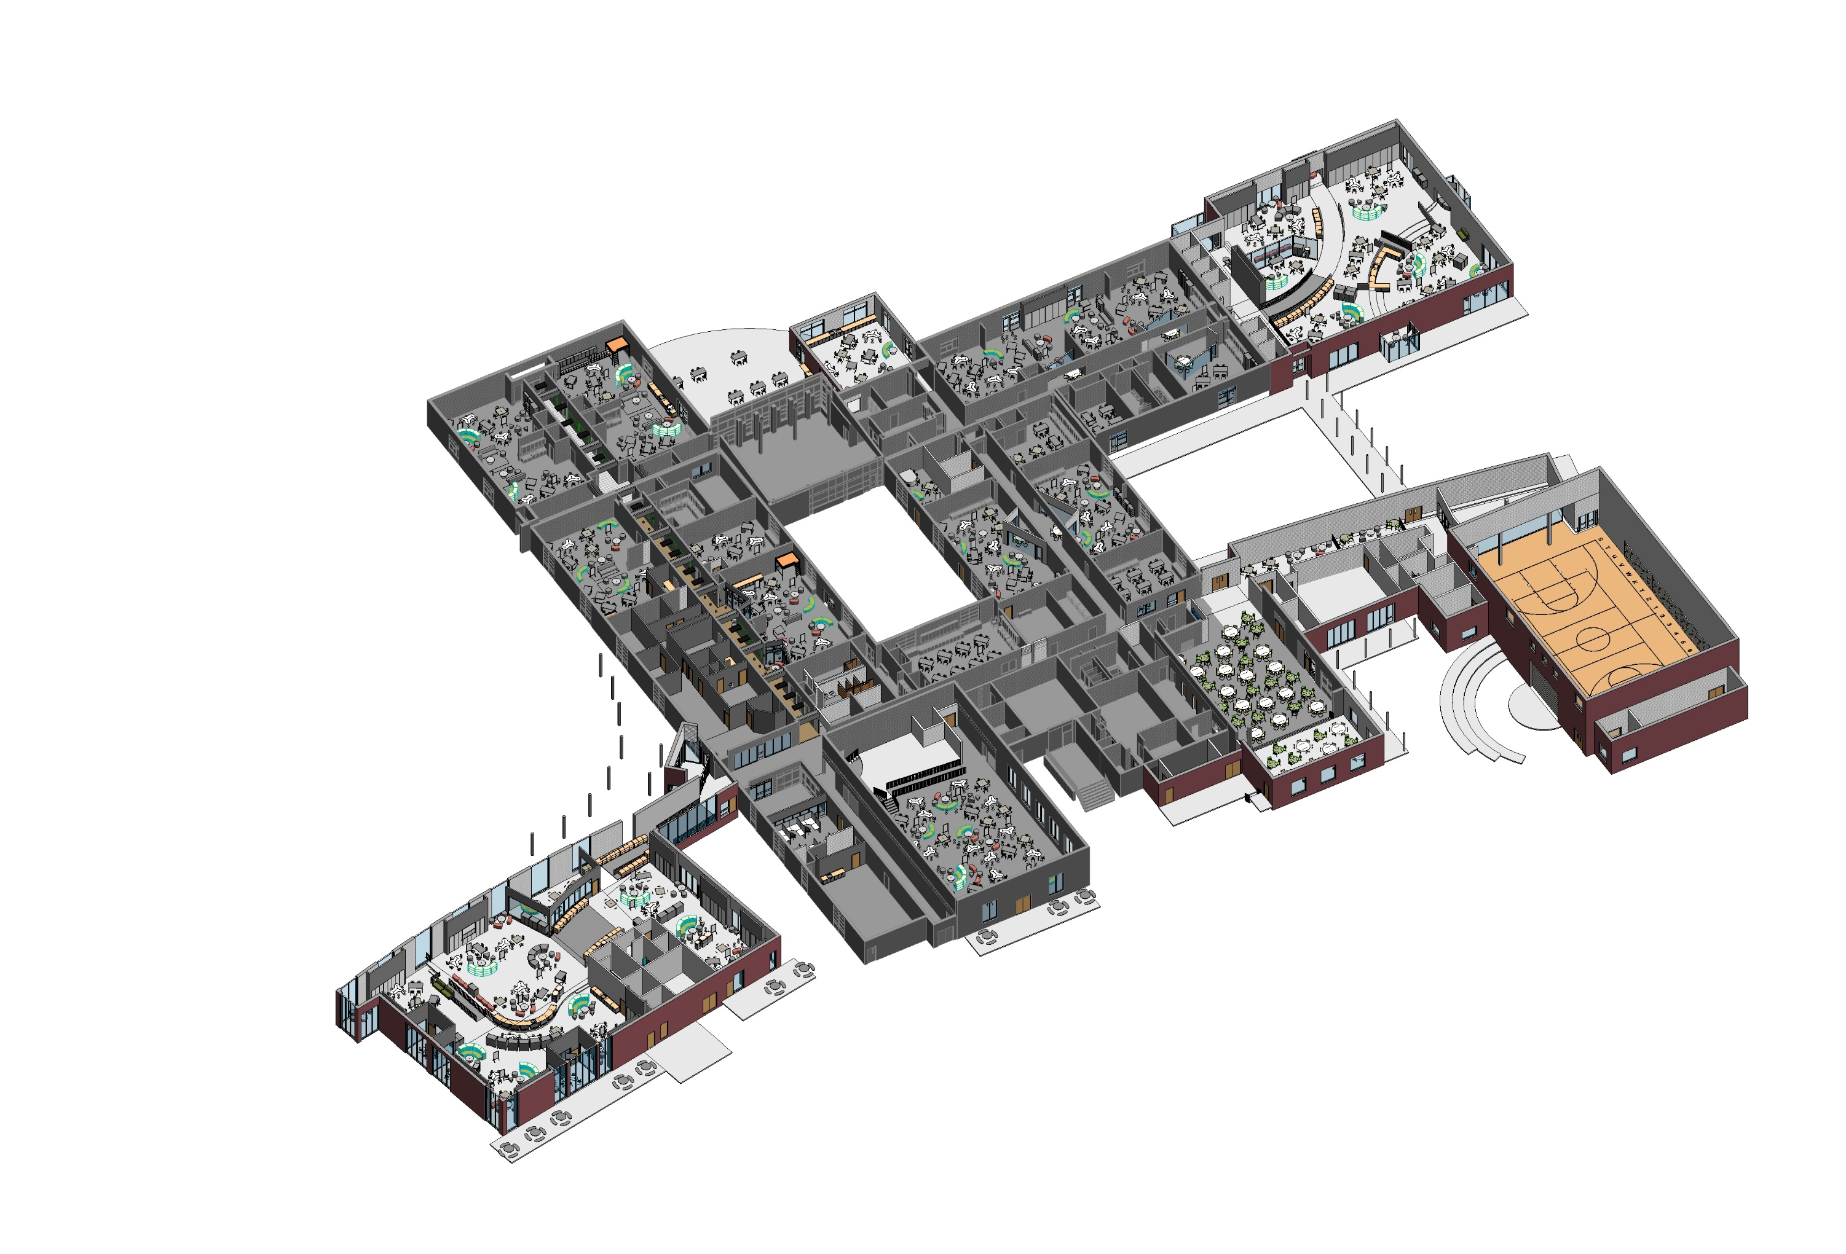

Slide 12
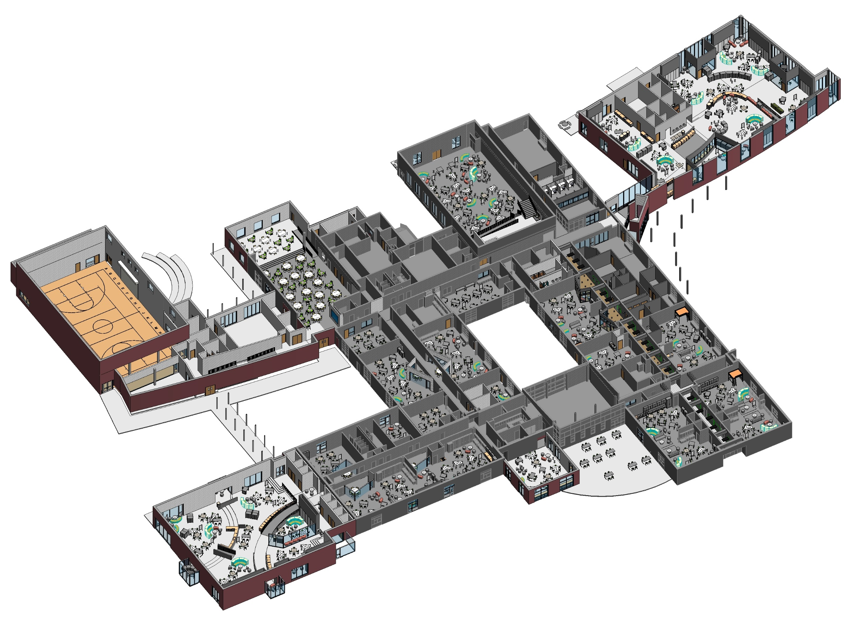

Slide 13
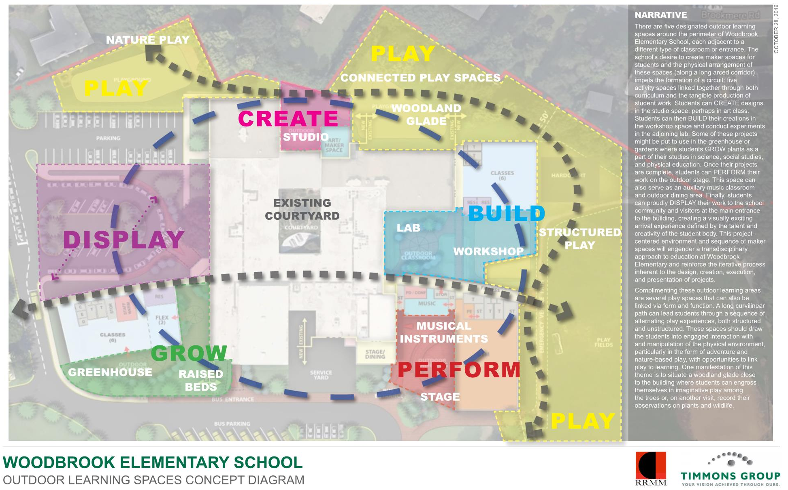

Slide 14
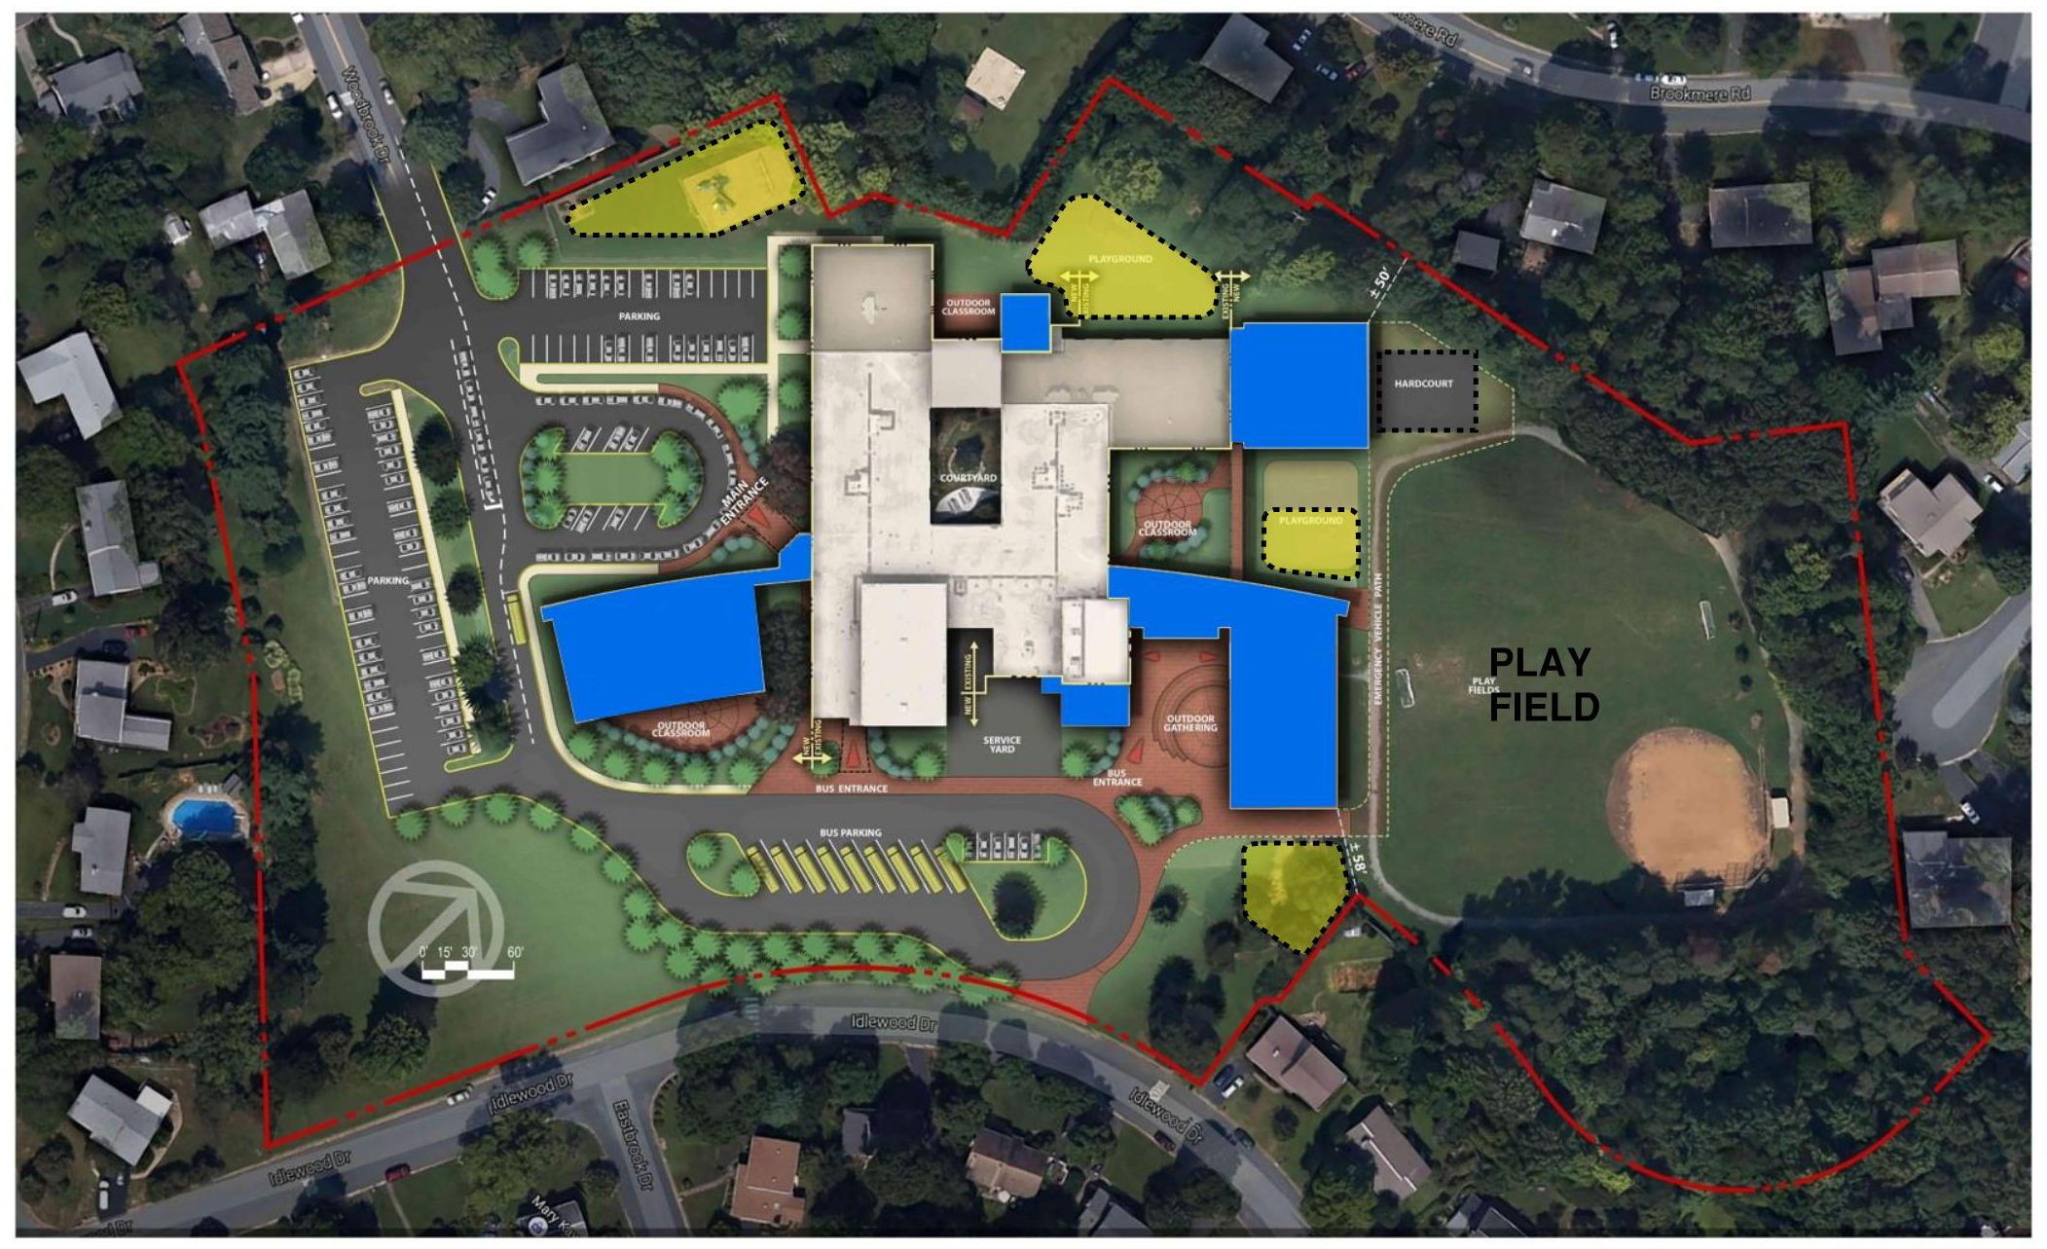

Slide 15
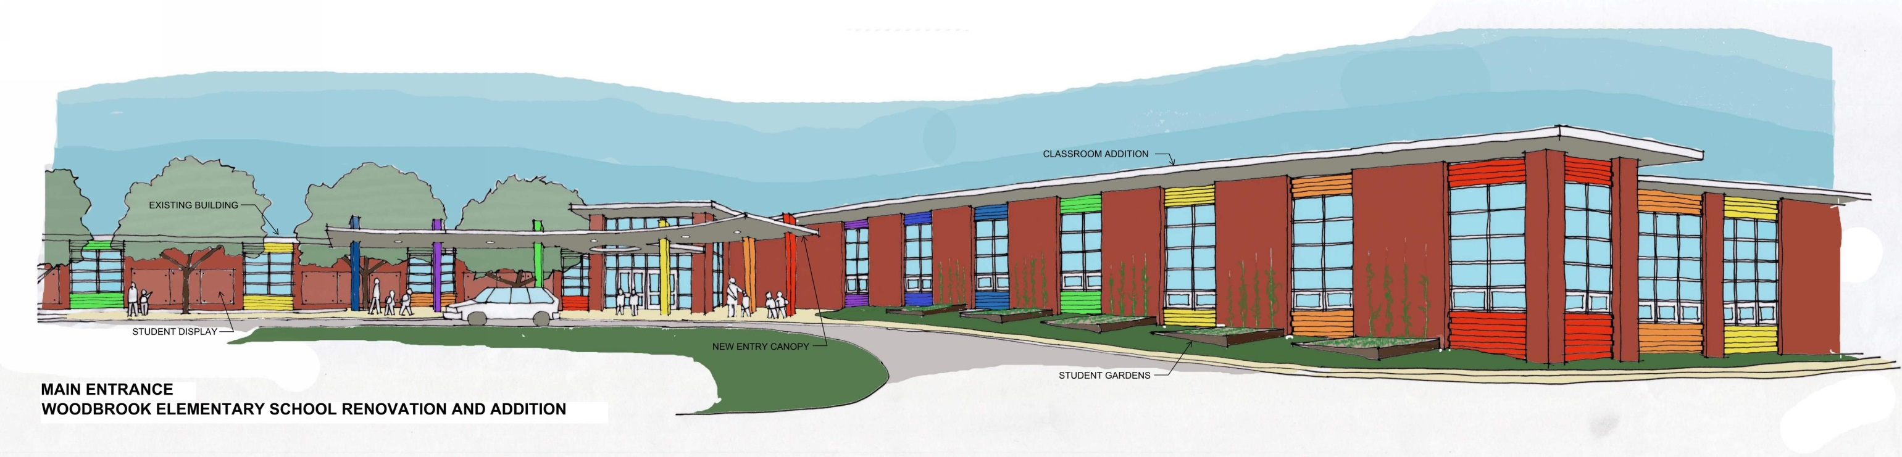

Slide 16


Slide 17
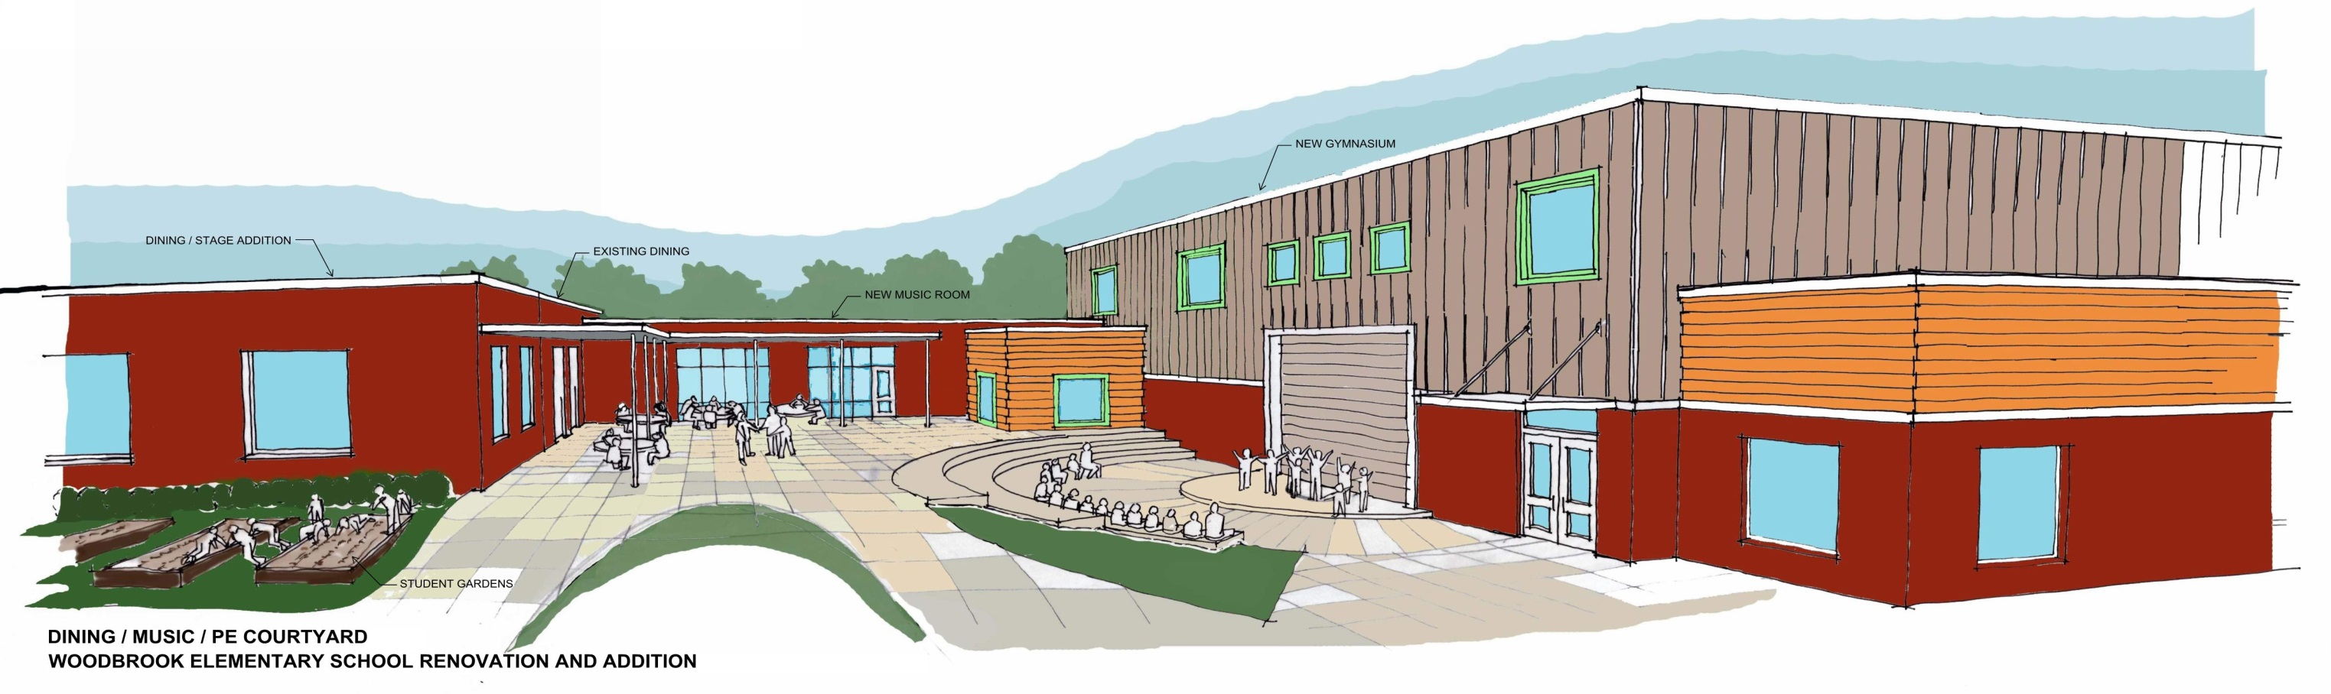

Slide 18
Next Steps
Planning and Design:
Continue the development of the plans for the project for sending out for Bids in March / April of 2017.
Furniture and Interior Design:
Continue with furniture selections and interior design finishes, colors, details and signage.
Project Schedule and Construction Phasing:
Develop the Construction Phasing Plan for the renovations during the summers of 2017 and 2018.
Construction of the Additions: June 2017 to July 2018.
Final Renovations: Fall of 2018.

Slide 19
Thank You

